Slide 1


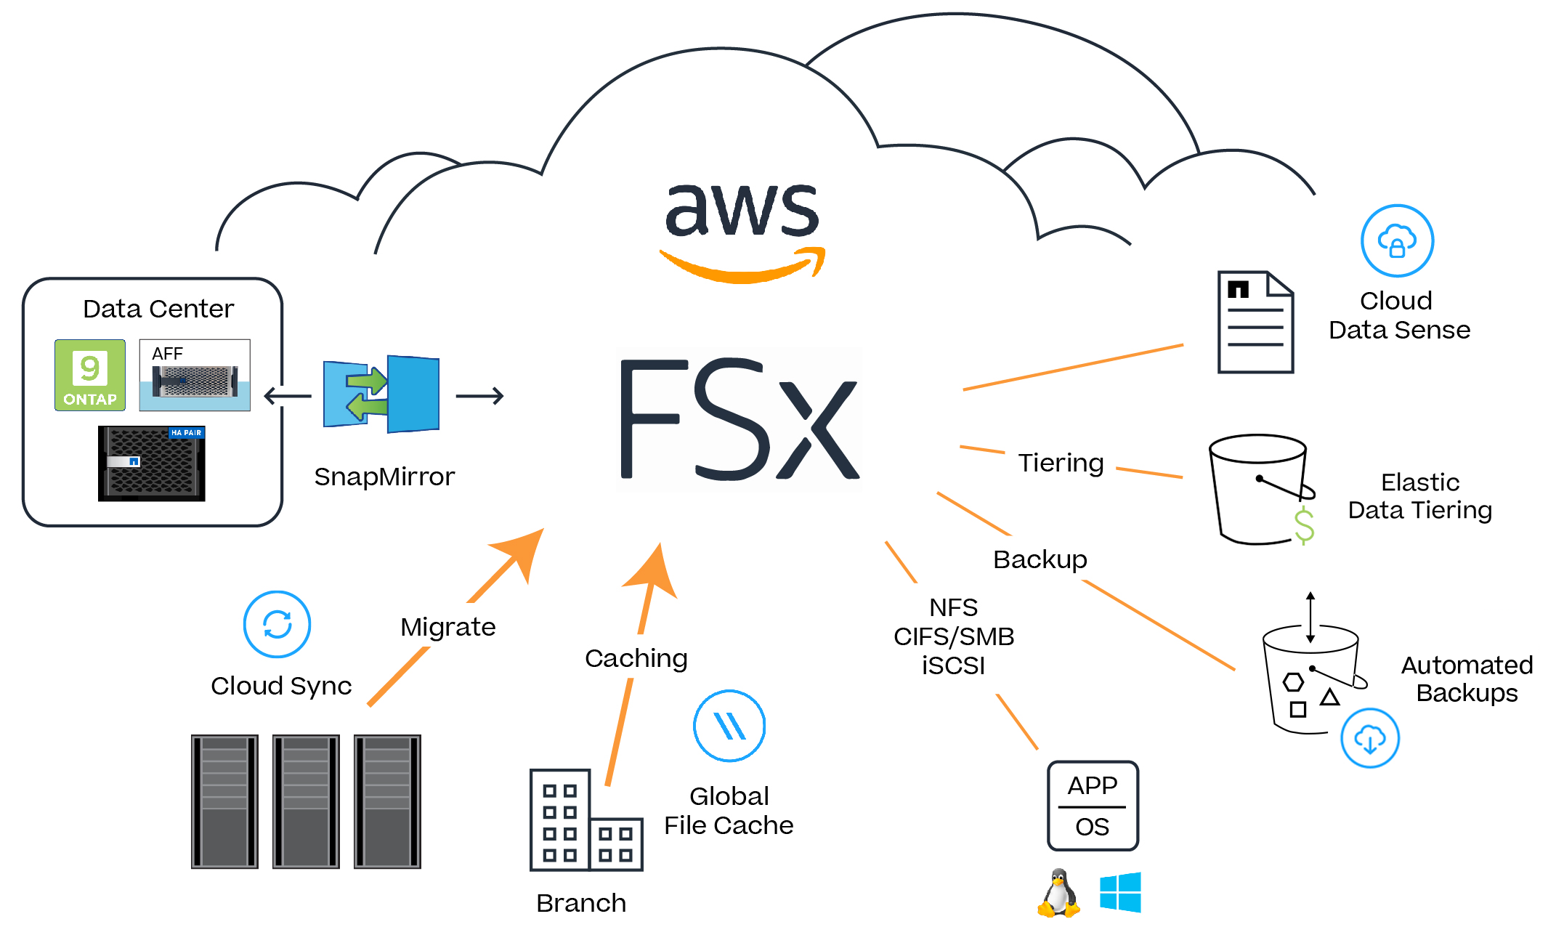

Key NetApp integrations
Accessible to the complete NetApp portfolio
Replication
Cloud
Data Sense
Data governance
SnapMirror
Amazon FSx for
NetApp ONTAP
Tiering
Cloud Tiering
Backup & recovery
Copy & sync
NFS
CIFS/SMB
iSCSI
Automated
Backups
Cloud Sync
File caching
Global File
Cache
Branch
NetApp BlueXP: Manage operations with a unified control plane delivering a simplified hybrid cloud experience for storage and data services across on-premises and AWS Cloud environments.
NetApp Cloud Insights: Monitor, remediate, and optimize resources and apps with observability services available through BlueXP.
Notes:
Easily extend to the cloud, migrate workloads, build modern apps, and eliminate management overhead with integration of the complete NetApp portfolio.
With BlueXP, you have a single pane control plane where you can consistently manage and monitor your data across clouds and on the premises.
I like to say FSx for ONTAP has a bi-directional UI …
Meaning those AWS centric customers can access everything from their familiar AWS UI And those familiar with ONTAP already can access it from their on-prem via BlueXP.
Thru BlueXP, you have access to everything that is great about ONTAP.
INCLUDING
Management, automation and orchestration
BlueXP extends the limited AWS APIs to automate a broad set of FSx data operations such as volume creation, replication, capacity management and more.
Performance Monitoring
BlueXP observability services using Cloud Insights provides advanced performance monitoring
Container and Compute infrastructure optimization
Spot Ocean supports FSx to provide end-to-end automated and optimized container infrastructure
Data protection, migration & Governance
BlueXP copy and sync service using Cloud Sync and BlueXP classification service using Cloud Data Sense allow customers to scan and migrate data to/from FSx
BlueXP backup and recovery service using Cloud Backup is Sold as AWS FSx Cloud Backup and is, leveraging NetApp’s block-level incremental forever-backups.
Caching (remote site and Edge)
FlexCache Separately licensed when FSx for ONTAP is the source volume
Global File Cache offers a caching solution for FSx
SnapCenter Support SC classic, similar to CVO
It can serve as primary storage for stateful Kubernetes applications running on Amazon EKS and Red Hat OpenShift on AWS, using NetApp’s Astra Trident dynamic storage provisioner.

Slide 2
Epic Data Stores and Reporting
Key Application Components
DR
Production
External EMR Data
HR Data
Epic Mirror
Cost Data
Epic Mirror
Cogito Caboodle
Epic DR
Epic Report
Epic Production
Integrated EHR Data
Clarity
Claims Data
Supply Chain Data
VMWare
Employee Satisfaction Data
External EMR Data
Patient Satisfaction Data
DR WebBLOB
WebBLOB
HyperSpace VDI
Notes:
Here’s a quick overview of the data stores and reporting architecture for Epic.
You’ll hear about Chronicles, which is the Cache database that supports the main EHR activity.
****It’s a nosql database and is extremely efficient for massive amounts of users to update the EHR at the same time.
Clarity is the data warehouse and relational database (typically an Oracle or Microsoft SQL database) designed for database developers.
****It enables users to create data-intensive reports without modifying user database, identify misuse of medications as well as reduce the incidence of medical error.
And Caboodle is comprised of the data warehouse and analytics tools for storing and retrieving large swaths of clinical data useful in reporting for care decision-making, cost management, and predictive analytics.

Slide 3


Epic Architecture: Key Components
Epic DR in the cloud
Epic Key Application Components
DR
Production
External EMR Data
HR Data
Epic Mirror
Epic Mirror
ETL
ETL
Cost Data
Epic DR
Epic Production
Epic Report
Clarity
Caboodle
(data warehouse)
Claims Data
Supply Chain Data
VMWare
External EMR Data
Employee Satisfaction Data
Patient Satisfaction Data
WebBLOB
DR
Storage
Replication
WebBLOB
HyperSpace VDI
= NAS
= SAN
= External Data
Notes:
Epic is made up of lots if different workloads,
Pool1-2-3, NAS1-2,
Then there is the 80% of HC workloads that touch Epic
Traditional approach is to build silo’s for each
– that is inefficient and costly,
~25% of HC spend is waisted on this.
Is there a single platform and strategy that can solve this?

Slide 4




Epic Automation deployment and data management
Epic DR in the cloud
The same management strategy and tools on-prem or in AWS
DR
Production
ETL
ETL
Iris Mirroring
Epic DR
Epic Production
Epic Report
Clarity
Caboodle
(data warehouse)
VMWare
Hyperspace VDI
Local Snapshot Backups
PJX
Backups
Backup
REL
SnapVault
Refresh test
Clones
SUP
WebBLOB
DR
WebBLOB
Tiering
CloudSync
Cold Data
Storage
Replication
SnapMirror
= SAN
= Backup-Clone-Tier
= NAS
Notes:
Pulling it all together with automation
Reduce deployment and operation time
Ensure best practice deployments
Ensure customers are leveraging the power of ONTAP
Better customer onboard experience
Meet all Epic requirements.

Slide 5


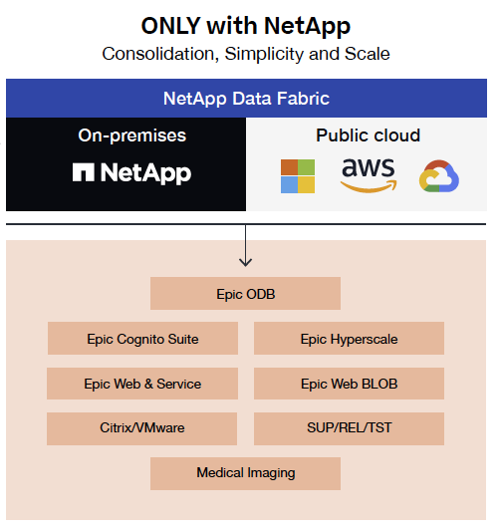
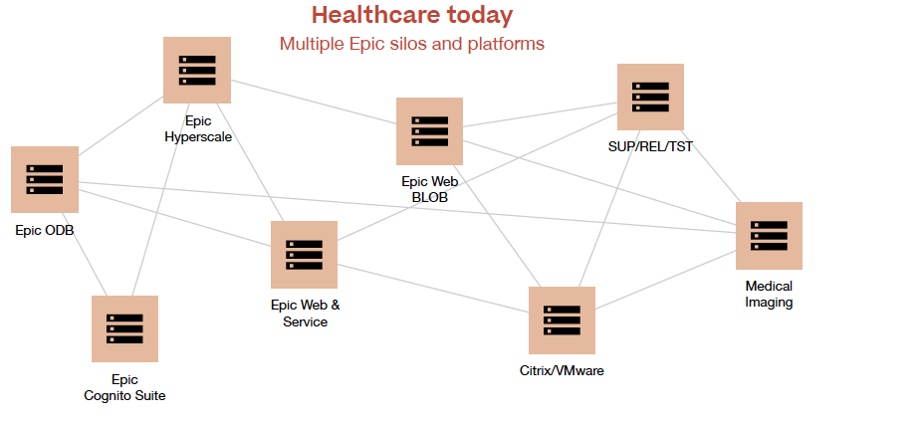


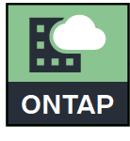
Overview – Scale and Simplicity for
Healthcare Today
Multiple Epic Silos and Platforms
With NetApp
Consolidation, Simplicity and Scale
Epic Hyperspace
Epic Cogito Suite
Epic Hyperspace
Epic Cogito Suite

Slide 6






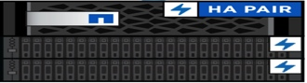
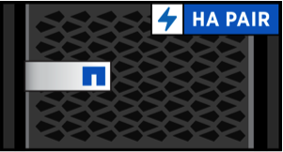
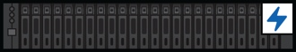














ONTAP Unified Storage
NAS
SAN
S3
NFS
SMB
FCP
iSCSI
FC-NVME
NVME/TCP
S3
MULTI- CLOUD
Scale up individual controllers
Cloud Volumes ONTAP
All Flash FAS (AFF)
FAS
NVMe/FC SSD
Seamlessly add
next generation
ONTAP Select
All Flash FAS (AFF)
FAS
Scale out
Common set of enterprise-grade features
Epic Iris
Cloud Insights
Cloud Backup Service
ActiveIQ
Data Tiering
Non-Disruptive Operations
Efficiency
SnapVault®
SnapMirror®
SnapLock®
Ransomware
Data fabric
Cloud Manager
Application integration
Spot
Notes:
ONLY with ONTAP you can Consolidate all Epic workloads
- File, Block and Object to ONTAP
- Pool 1-2-3, NAS 1-2 and the 4-5X non-Epic workloads
Add AFF with FAS with Next Gen and move workloads non disruptively
Never Migrate again and disrupt the business.
Advance application integration, putting tools in the hands of the Application owners
NetApp Ransomware suit
CAN we Do all this in FSxN????

Slide 7
Epic Data Stores and Reporting
Key Application Components
Production
DR
Epic Mirror
Epic Mirror
Production Database Server
Failover Database Server
Reporting Database Server
DR Database Server
Database Storage
Database Storage
Database Storage
Notes:
Here’s a quick overview of the data stores and reporting architecture for Epic.
You’ll hear about Chronicles, which is the Cache database that supports the main EHR activity.
****It’s a nosql database and is extremely efficient for massive amounts of users to update the EHR at the same time.
Clarity is the data warehouse and relational database (typically an Oracle or Microsoft SQL database) designed for database developers.
****It enables users to create data-intensive reports without modifying user database, identify misuse of medications as well as reduce the incidence of medical error.
And Caboodle is comprised of the data warehouse and analytics tools for storing and retrieving large swaths of clinical data useful in reporting for care decision-making, cost management, and predictive analytics.

Slide 8
Effective
Raw
1,323,560
386,400
Usable
RAID DP
& ADP
75% Usable
260,800
5.2:1
852,800
Effective Used
64%
166,786
96
X
3.8TB

Slide 9




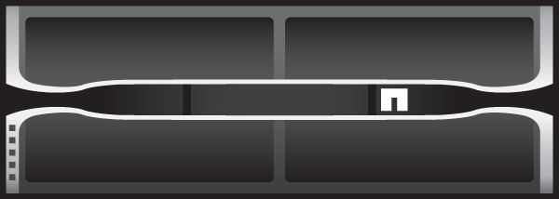
Epic Production Cluster
Epic DR Cluster
prod-01
prod-02
dr-01
dr-02
Epic Prod
Epic Report
Daily Dumps
DR Prod
Hyperspace
Clone
Epic Mirror
Epic Mirror
VMware
Backup Clone
Clarity
WebBLOB
Workload data
Snapshot/clone
DB replication
Backup
Test refresh
Backup Clone
Clone
SUP Clone
Hyperspace
REL Clone
VMware
SnapMirror with mirror or vault policy
VAL Clone
WebBLOB
Mount
Epic Cache Mirror
Hyphenate real-time async cache database replication to read only Report, and DR.
Mount
Backup Workflows
Nightly automated application consistent backup of Epic production using host side freeze and thaw scripts
Most recent backup is mounted on Media server and streamed to Archive via backup software.
Or optionally automation to SnapMirror with a vault policy to ONTAP
Epic Prod
None Prod
Report Prod
Backup media
Stream backup
Epic DR
Report DR
Freeze/Thaw
Envcopy
REST API
REST API
REST API
Optional bypass media server and use SnapMirror with vault policy
Archive
Refresh Workflows
Nonproduction server starts envcopy scripts to bring down SUP environment and save env variables.
LUNs are removed and rebuilt from clone of latest Snapshot copy and presented to server.
Envcopy brings SUP DB back online.
This process is repeated for all full copy test environments.
vCenter
Automation
Active IQ
Unified Manager
Automation
Notes:
4-node design diagram is used for TR-3928 – NetApp Best Practices for Epic. With no AQOS

Slide 10


Epic Production Cluster
Epic DR Cluster
prod-01
prod-02
prod-03
prod-04
dr-01
dr-02
Epic Report
Hyperspace
Epic Prod
Epic Report
Clarity
WebBLOB
DR Prod
Epic Mirror
Daily Dump
Epic Mirror
VMware
SnapMirror
WebBLOB
Epic Backup
Hyperspace
Clone
Workload data
Snapshot/clone
DB replication
Backup
Test refresh
Backup Clone
VMware
SnapMirror with mirror or vault policy
Clone
SUP Clone
REL Clone
Optional bypass media server and use SnapMirror with vault policy
Mount
VAL Clone
Epic Cache Mirror
Hyphenate real-time async cache database replication to read only Report, and DR.
Mount
Backup Workflows
Nightly automated application consistent backup of Epic production using host side freeze and thaw scripts
Most recent backup is mounted on Media server and streamed to Archive via backup software.
Or optionally automation to SnapMirror with a vault policy to ONTAP
Epic Prod
Report Prod
None Prod
Backup Media
Epic DR
Report DR
Freeze/Thaw
Envcopy
REST API
REST API
REST API
Stream Backup
Refresh Workflows
Nonproduction server starts envcopy scripts to bring down SUP environment and save env variables.
LUNs are removed and rebuilt from clone of latest Snapshot copy and presented to server.
Envcopy brings SUP DB back online.
This process is repeated for all full copy test environments.
vCenter
Archive
Automation
Active IQ Unified Manager
Automation
Notes:
6-node design diagram is used for TR-3928 – NetApp Best Practices for Epic. With no AQOS

Slide 11
Epic Production Cluster
prod-01
prod-02
report-03
report-04
report-05
report-06
clarity-07
clarity-08
Epic Prod
Golden Image
Report
Clarity
Epic Report
Daily DB Bump
SnapMirror with vault policy
Clone
Epic Mirror
Workload data
Snapshot/clone
DB replication
Backup
Test refresh
Backup Clone
Epic Mirror
To DR
Clone
SUP Clone
Epic Prod
Report Prod
Freeze/Thaw
REL Clone
Mount
VAL Clone
Optional bypass media server and use SnapMirror with vault policy
Epic Cache Mirror
Hyphenate real-time async cache database replication to read only Report, and DR.
Mount
REST API
Backup Workflows
Nightly automated application consistent backup of Epic production using host side freeze and thaw scripts
Most recent backup is mounted on Media server and streamed to Archive via backup software.
Or optionally automation to SnapMirror with a vault policy to ONTAP
None Prod
Backup Media
Envcopy
REST API
REST API
Refresh Workflows
Nonproduction server starts envcopy scripts to bring down SUP environment and save env variables.
LUNs are removed and rebuilt from clone of latest Snapshot copy and presented to server.
Envcopy brings SUP DB back online.
This process is repeated for all full copy test environments.
Stream Backup
Active IQ Unified Manager
VCenter
Archive
Automation

Slide 12
Epic Production Cluster
Epic DR Cluster
prod-01
prod-02
prod-03
prod-04
dr-01
dr-02
Epic Backup
Epic Report
Epic Backup
Clarity
Clone
Daily DB Dump
Epic Mirror
Epic Mirror
Epic Report
Hyperspace
DR Hyperspace
Workload data
Snapshot/clone
DB replication
Backup
Test refresh
Clone
Backup Clone
VMware
SnapMirror with mirror or vault policy
DR VMware
SUP Clone
WebBLOB
DR WebBLOB
REL Clone
Optional bypass media server and use SnapMirror with vault policy
Mount
VAL Clone
Epic Cache Mirror
Hyphenate real-time async cache database replication to read only Report, and DR.
Stream Backup
Backup Workflows
Nightly automated application consistent backup of Epic production using host side freeze and thaw scripts
Most recent backup is mounted on Media server and streamed to Archive via backup software.
Or optionally automation to SnapMirror with a vault policy to ONTAP
Mount
None Prod
Epic Prod
Report Prod
Backup Media
Archive
Epic DR
Report DR
Envcopy
Freeze/Thaw
RESTAPI
REST API
RESTAPI
Refresh Workflows
Nonproduction server starts envcopy scripts to bring down SUP environment and save env variables.
LUNs are removed and rebuilt from clone of latest Snapshot copy and presented to server.
Envcopy brings SUP DB back online.
This process is repeated for all full copy test environments.
Active IQ Unified Manager
Automation
vCenter
Automation
Notes:
6-node design diagram is used for TR-3928 – NetApp Best Practices for Epic. With AQOS

Slide 13
Epic Prod
and Test Servers
Epic Report
and Test Servers
Report
Clarity
Prod Services
Prod-01
Prod-02
Prod-03
Prod-04
Prod-05
Prod-02
Production Database Storage
Production Journal Storage
Production Application Storage
Production Database Storage
Production Journal Storage
Production Application Storage
Report Database Storage
Report Journal Storage
Report Application Storage
Report Database Storage
Report Journal Storage
Report Application Storage
Clarity Database Storage
Clarity Database Storage
VMware
Hyperspace
VMware
Hyperspace
Test, training, development
Test, training, development
WebBLOB
WebBLOB
Epic DR Servers
DR services
DR-01
DR-02
DR Database Storage
DR Journal Storage
DR Application Storage
DR Database Storage
DR Journal Storage
DR Application Storage
DR Services
DR Services

Slide 14
Epic Prod
and Test Servers
Production Database Storage
Production Journal Storage
Production Application Storage
Prod-01
Test, training, development
Report
Clarity
Prod Services
Report Database Storage
Report Journal Storage
Report Application Storage
Clarity Database Storage
Prod-02
VMware
Hyperspace
WebBLOB, business objects, archive
Epic DR Server
DR Database Storage
DR Journal Storage
DR Application Storage
DR-01
DR services
DR Services
DR-02

Slide 15
Epic Prod Server
Production Database Storage
Production Journal Storage
Production Application Storage
Prod-01
Epic Report Server
Report Database Storage
Report Journal Storage
Report Application Storage
Prod-02
Clarity Server
Clarity Database Storage
Prod-03
Test, training, development
Prod Servcies
VMware
Hyperspace
Prod-04
WebBLOB, business objects, archive
Epic DR Server
DR Database Storage
DR Journal Storage
DR Application Storage
DR-01
DR services
DR VMware
DR Hyperspace
DR-02
DR WebBLOB, business objects, archive

Slide 16
Production Database Storage
Epic Prod Server
Prod-01
Production Database Storage
Prod-02
Report Database Storage
Epic Test Server
Prod-03
Report Database Storage
Prod-04
Report Database Storage
Prod-05
Epic Report Server
Report Database Storage
Prod-06
Clarity Database Storage
Prod-07
Clarity Server
Clarity Database Storage
Prod-08

Slide 17
Epic Prod Server
Production Database & journals
Report Database & journals
Prod-01
Test, training, development
Epic Report Server
Production Database & journals
Epic Report Server
Report Database & journals
Prod-02
Test, training, development
Clarity Server
Clarity Database Storage
WebBLOB, business objects, archive
Prod-03
VMware & Hyperspace
Prod Servcies
Clarity Database Storage
WebBLOB, business objects, archive
Prod-04
VMware & Hyperspace
Epic DR Server
DR Database Storage
DR Journal Storage
DR Application Storage
DR-01
DR services
DR VMware
DR Hyperspace
DR-02
DR WebBLOB, business objects, archive

Slide 18

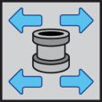
Epic Production Cluster
N1_Aggr1 ONTAP
Production DB LUNs
Nightly backup to disk
N2_Aggr1 ONTAP
Production JRNS & Apps
Report DB, JRNS & Apps
N3_Aggr1 ONTAP
Clarity
Test
N4_Aggr1 ONTAP
Production services
NAS
MultiPath HA for all disk
Multipath HA for all disk
N1_Aggr0 ONTAP ADP
N2_Aggr0 ONTAP ADP
N3_Aggr0 ONTAP ADP
N4_Aggr0 ONTAP ADP
HA Pair
HA Pair
Node1
FCP Data
Node2
SnapMirror
(Optional)*
Node1
FCP Data
Node2
Highly available CIFS shares
Archive Data
Wed BLOB Server Data
Business Objects Enterprise Data
Multipurpose SQL Server Data
Relay Server Data
Nonproduction Service Server Data
Epic Prod
FCP Data
Epic Mirror over TCP/IP
To DR
DC
FCP Data
Replication:
SnapMirror Epic prod to node3 to offload backup and test refresh.
Epic Mirror from Epic Prod to Epic DR over WAN
*Test can optionally be run on Node1 or Node2 without SnapMirror.
Backup:
Epic Prod nightly backups to disk on Node1
Long term backup can be either SnapVault to remote ONTAP or mounted and streamed from a media server
Production Server
Backup\Test Server
Report Server
Clarity Server
Business Objects
Data Warehouse
WebBLOB Server

Slide 19
Epic Production Cluster
SnapMirror
Epic
DR
N1_Aggr5 ONTAP
Epic DR
Nightly backup to disk
N6_Aggr1 ONTAP
DR Services
DR backup
MultiPath HA for all disk
N5_Aggr0 ONTAP ADP
N6_Aggr0 ONTAP ADP
HA Pair
Node5
FCP Data
Node6
From
Prod
Epic Mirror over TCP/IP
FCP Data
Replication:
SnapMirror Epic DR to node6.
Epic Mirror from Epic Prod to Epic DR over WAN
Backup:
Epic DR nightly backups to disk on Node5
Long term backup can be either SnapVault to remote ONTAP or mounted and streamed from a media server
Production Server
Backup\Test Server
Report Server
Clarity Server
Business Objects
Data Warehouse
WebBLOB Server

Slide 20
Figure 2) Storage layout for one storage system.
Production DB Server
Report DB Server
Production DB LUNs
Production DB LUNs
LUN
LUN
LUN
LUN
LUN
LUN
LUN
LUN
Production Journal
and installs LUNs
Aggregate
Aggregate
Node 1
Node 2

Slide 21


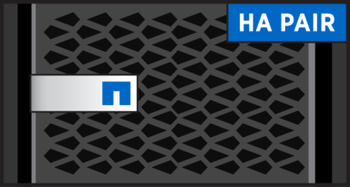
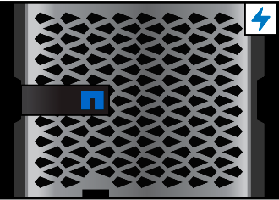






Stage 1 Detect and Initiate
Stage 2 Switchover
Stage 3 Restore Data Services

Slide 22











Cloud Disaster Recovery for Epic
Cloud Volumes ONTAP
On-Premise Datacenter
Cloud Disaster Recovery
Epic DR
DR Non-Prod
Hyperspace
Iris Mirroring
APP
APP
APP
Daily DB Dump
OS
OS
OS
Epic Prod
Report Prod
Non-Prod
Clarity
Hyperspace
APP
APP
APP
APP
APP
OS
OS
OS
OS
OS
NetApp SnapMirror
EPIC EHR DATA MANAGEMENT
Resource Management
Cloud Insights Spot Cloud Analyzer Virtual Desktop Service
Backup Service
Cloud Backup
Compliance & Security
Cloud Compliance Cloud Secure
Data Migration
Cloud Sync Cloud Tiering
Automation
Ansible REST API
*
Notes:
Epic has no interest in partnering with Google

Slide 23
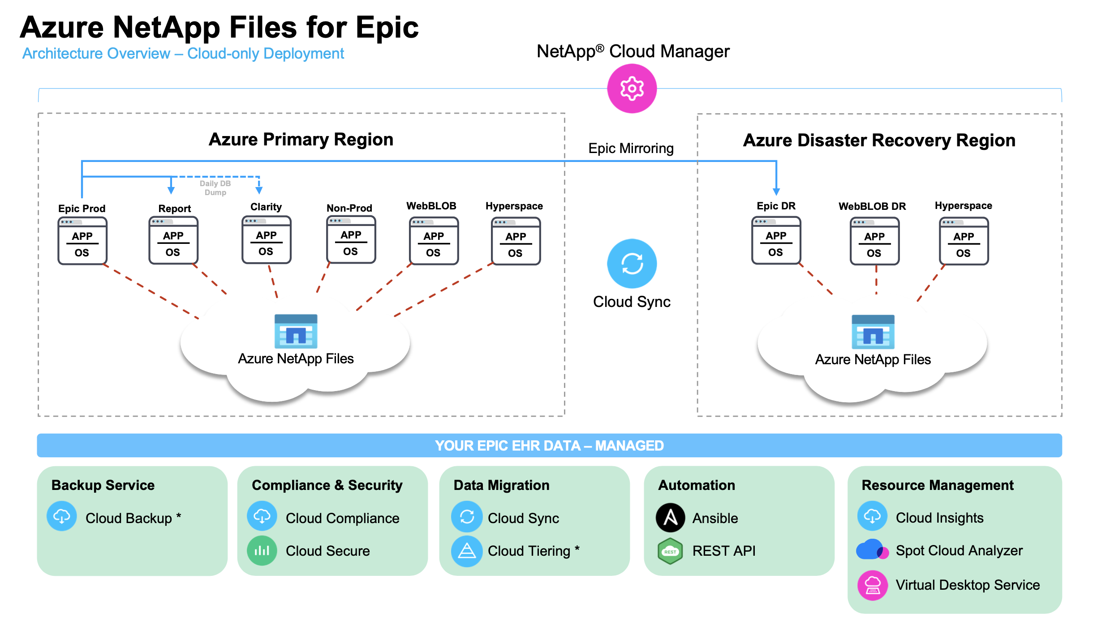
Cross Region Replication

Slide 24
Epic Production in Azure
Epic DR in Azure
Epic Mirror
Daily DB Dump
Epic Prod
Report Prod
None Prod
Clarity
Hyperspace
Epic DR
DR Test
DR Non-Prod
Hyperspace
NFS/SMB
NFS/SMB
Azure NetApp Files
Azure NetApp Files
Prod Ultra Capacity Pool
Prod Standard Capacity Pool
DR Standard Capacity Pool
DR Ultra Capacity Pool
Epic Prod (NFS)
Clone
Move
Backup Clone
Epic DR
Epic Report
Epic DR
Epic Report (NFS)
SUP Clone 30TB
Backup Clone
Clone
Clarity (SMB)
REL Clone 30TB
DR WebBLOB
Hyperspace (SMB)
PJX Clone 30TB
Cross Regional Replication
WebBLOB (SMB)

Slide 25


Epic On Prem Production Cluster
Epic DR in Azure
Epic Mirror
Daily DB Dump
Epic Prod
Report Prod
None Prod
Clarity
Hyperspace
Epic DR
DR Test
DR Non-Prod
Hyperspace
FCP/NVMe/SMB
NFS/SMB
ONTAP Cluster
Azure NetApp Files
DR Standard Capacity Pool
DR Ultra Capacity Pool
Epic Prod
Clarity
Epic DR
Move
Epic Report
Epic DR
Epic Report
Hyperspace
Backup Clone
Clone
Backup Clone
VMware
Cloud Sync
DR WebBLOB
Clone
SUP Clone 30TB
WebBLOB (SMB)
Test Clone
REL Clone 30TB
PJX Clone 30TB

Slide 26
Epic On Prem Production Cluster
Epic DR2 in Azure
Epic Mirror
Daily DB Dump
Epic Prod
Report Prod
None Prod
Clarity
Hyperspace
Epic DR2
DR Test
DR Non-Prod
Hyperspace
FCP/NVMe/SMB
NFS/SMB
ONTAP Cluster
Azure NetApp Files
DR Standard Capacity Pool
Epic Prod
Clarity
Epic DR2
Epic Report
Epic Report
Hyperspace
Backup Clone
Backup Clone
VMware
SUP Clone 30TB
Test Clone
WebBLOB (SMB)
REL Clone 30TB
PJX Clone 30TB

Slide 27
Epic Aggregate, Volume, LUN layout
Each of volumes below are presented to a single Epic instance like prod, report or dr.
Node1_Aggr1
Node2_Aggr1
FlexVolume
db01
db03
db05
db07
jrn1
inst1
db02
db04
db06
db08
jrn02
inst2
db01
db03
db5
db7
jrn1
inst1
db2
db4
db6
db8
jrn2
inst2
LUN

Slide 28
Epic Aggregate, Volume, LUN layout
Each of volumes below are presented to a single Epic instance like prod, report or dr.
Node1_Aggr1
Node2_Aggr1
FlexVolume
db01
db03
db05
db07
jrn1
inst1
db02
db04
db06
db08
jrn02
inst2
db01
db03
db5
db7
jrn1
inst1
db2
db4
db6
db8
jrn2
inst2
LUN
db09
db11
db13
db15
jrn3
db10
db12
db14
db16
jrn4

Slide 29
Epic Aggregate, Volume, LUN layout
Each of volumes below are presented to a single Epic instance like prod, report or dr.
Node1_Aggr1
Node2_Aggr1
FlexVolume
db01
db03
db05
db07
jrn1
inst1
db02
db04
db06
db08
jrn02
inst2
db01
db03
db5
db7
jrn1
inst1
db2
db4
db6
db8
jrn2
inst2
LUN
db09
db11
db13
db15
jrn3
db10
db12
db14
db16
jrn4
db17
db19
db21
db23
jrn5
db18
db20
db22
db24
jrn6

Slide 30
Epic Aggregate, Volume, LUN layout
Each of volumes below are presented to a single Epic instance like prod, report or dr.
Node1_Aggr1
Node2_Aggr1
FlexVolume
db01
db03
db05
db07
jrn1
inst1
db02
db04
db06
db08
jrn02
inst2
db01
db03
db5
db7
jrn1
inst1
db2
db4
db6
db8
jrn2
inst2
LUN
db09
db11
db13
db15
jrn3
db10
db12
db14
db16
jrn4
db17
db19
db21
db23
jrn5
db18
db20
db22
db24
jrn6
db25
db27
db29
db31
jrn7
db26
db28
db30
db32
jrn8

Slide 31
Epic Production Cluster
Epic DR Cluster
prod-01
prod-02
dr-01
dr-02
Epic Prod
Epic Report
Daily Dumps
DR Prod
Hyperspace
Clone
Epic Mirror
Epic Mirror
VMware
Backup Clone
Clarity
WebBLOB
Workload Data
Snapshot/Clone
DB replication
Backup
Test refresh
Backup Clone
Clone
SUP Clone
Hyperspace
REL Clone
VMware
SnapMirror(R)
SnapVault(R)
VAL Clone
WebBLOB
Epic Cache Mirror
hyphenate real-time async cache database replication to read only Report, and DR.
Mount
Mount
Backup Workflows
Nightly WFA application consistent backup of Epic production using host side Freeze and Thaw scripts
Most recent backup is mounted on Media server and streamed to Archive via backup software.
Or optionally WFA can SnapVault to ONTAP
Epic Prod
None Prod
Report Prod
Backup Media
Stream Backup
Epic DR
Report DR
Freeze/Thaw
Envcopy
REST API
REST API
REST API
Refresh Workflows
Nonproduction server starts envcopy scripts to bring down SUP environment and save env variables.
LUNs are removed and rebuilt from clone of latest Snapshot copy and presented to server.
Envcopy brings SUP DB back online.
This process is repeated for all full copy test environments.
Optional bypass media server and use SnapVault(R)
VCenter
Archive
Workflow Automation
OnCommand(R) Unified Manager
Workflow Automation
Notes:
4-node design diagram is used for TR-3928 – NetApp Best Practices for Epic. With no AQOS

Slide 32
Epic Production Cluster
Epic DR Cluster
prod-01
prod-02
prod-03
prod-04
dr-01
dr-02
Epic Report
Epic Prod
Epic Report
Clarity
WebBLOB
DR Prod
WebBLOB
Epic Mirror
Daily Dump
Epic Mirror
Hyperspace
Workload Data
Snapshot/Clone
DB replication
Backup
Test refresh
SnapMirror(R)
VMware
Epic Backup
Hyperspace
Clone
SnapMirror
SnapVault
Backup Clone
VMware
Clone
SUP Clone
REL Clone
Optional bypass media server and use SnapVault(R)
Epic Cache Mirror
hyphenate real-time async cache database replication to read only Report, and DR.
Mount
VAL Clone
Backup Workflows
Nightly WFA application consistent backup of Epic production using host side Freeze and Thaw scripts
Most recent backup is mounted on Media server and streamed to Archive via backup software.
Or optionally WFA can SnapVault to ONTAP
Mount
Epic Prod
Report Prod
None Prod
Backup Media
Epic DR
Report DR
Freeze/Thaw
Envcopy
Refresh Workflows
Nonproduction server starts envcopy scripts to bring down SUP environment and save env variables.
LUNs are removed and rebuilt from clone of latest Snapshot copy and presented to server.
Envcopy brings SUP DB back online.
This process is repeated for all full copy test environments.
API Call
API Call
API Call
Stream Backup
VCenter
Archive
Workflow Automation
OnCommand(R) Unified Manager
Workflow Automation
Notes:
6-node design diagram is used for TR-3928 – NetApp Best Practices for Epic. With no AQOS

Slide 33
Epic Production Cluster
prod-01
prod-02
report-03
report-04
report-05
report-06
clarity-07
clarity-08
Epic Prod
Golden Image
Report
Clarity
Epic Report
Epic Mirror
Daily DB Bump
SnapVault(R)
Clone
Backup Clone
Workload Data
Snapshot/Clone
DB replication
Backup
Test refresh
Epic Mirror
To DR
Clone
SUP Clone
Epic Prod
Report Prod
Freeze/Thaw
REL Clone
Mount
VAL Clone
Optional bypass media server and use SnapVault(R)
Epic Cache Mirror
hyphenate real-time async cache database replication to read only Report, and DR.
Mount
Backup Workflows
Nightly WFA application consistent backup of Epic production using host side Freeze and Thaw scripts
Most recent backup is mounted on Media server and streamed to Archive via backup software.
Or optionally WFA can SnapVault to ONTAP
None Prod
Backup Media
Envcopy
REST API
REST API
Refresh Workflows
Nonproduction server starts envcopy scripts to bring down SUP environment and save env variables.
LUNs are removed and rebuilt from clone of latest Snapshot copy and presented to server.
Envcopy brings SUP DB back online.
This process is repeated for all full copy test environments.
Stream Backup
OnCommand(R) Unified Manager
VCenter
Archive
Workflow Automation

Slide 34
Epic Production Cluster
Epic DR Cluster
prod-01
prod-02
prod-03
prod-04
dr-01
dr-02
Epic Backup
Epic Report
Epic Backup
Clarity
Clone
Daily DB Dump
Epic Mirror
Epic Mirror
Epic Report
Hyperspace
DR Hyperspace
Workload Data
Snapshot/Clone
DB replication
Backup
Test refresh
Clone
SnapMirror
SnapVault
Backup Clone
VMware
DR VMware
SUP Clone
WebBLOB
DR WebBLOB
REL Clone
Optional bypass media server and use SnapVault(R)
Mount
Epic Cache Mirror
hyphenate real-time async cache database replication to read only Report, and DR.
VAL Clone
Archive
Backup Workflows
Nightly WFA application consistent backup of Epic production using host side Freeze and Thaw scripts
Most recent backup is mounted on Media server and streamed to Archive via backup software.
Or optionally WFA can SnapVault to ONTAP
Mount
Stream Backup
None Prod
Epic Prod
Report Prod
Backup Media
Epic DR
Report DR
Envcopy
Freeze/Thaw
API Call
Refresh Workflows
Nonproduction server starts envcopy scripts to bring down SUP environment and save env variables.
LUNs are removed and rebuilt from clone of latest Snapshot copy and presented to server.
Envcopy brings SUP DB back online.
This process is repeated for all full copy test environments.
API Call
API Call
OnCommand(R) Unified Manager
Workflow Automation
VCenter
Workflow Automation
Notes:
6-node design diagram is used for TR-3928 – NetApp Best Practices for Epic. With AQOS

Slide 35


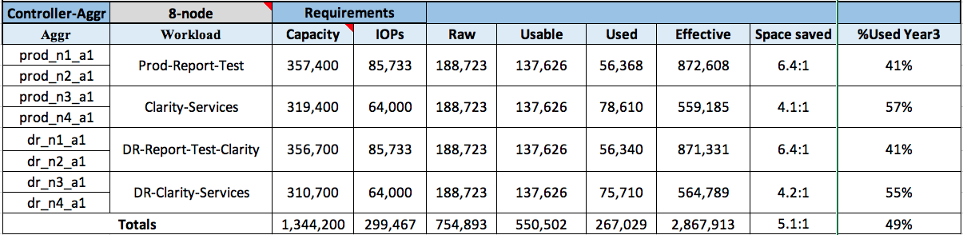
Epic Production Cluster
Epic DR Cluster
Workloads should be balanced across HA pair to maximize performance
Node_1/2
Node_3/4
Node_5/6
Node_7/8
Epic Production
Clarity
Epic DR
DR Clarity
Epic Report
Daily DB Dump
Epic Mirror
Epic Report
Hyperspace
DR Report
DR Hyperspace
VMware Optional
VMware
VMware Optional
VMware
FlexGroup Optional
FlexGroup NAS
FlexGroup Optional
FlexGroup NAS
Clone
Clone
Optional bypass media server and use SnapVault(R)
Backup Clone
Epic Mirror DB replication
Backup Workflow
SUP Clone
Mount
Stream Backup
Test refresh Workflow
REL Clone
Backup Media
Archive
VAL Clone
Mount
Storage Summary
API
None Prod
EnvCopy
Report Prod
Epic Prod
WFA
Freeze/Thaw
API
API

Slide 36




Epic Production Cluster
Epic DR Cluster
Epic Production
Clarity
Epic DR
DR Clarity
Epic Report
Daily DB Dump
DR Hyperspace
Epic Mirror
Clone
Epic Report
Hyperspace
DR Report
DR VMware
Clone
VMware
Ready today to run Epic DR in the cloud or Next to the cloud (CVO or NPS)
DR WebBLOB
Backup Clone
SUP Clone
WebBLOB
REL Clone
VAL Clone
Optional bypass media server and use SnapVault(R)
Stream Backup
Archive
Epic Cloud
Mount
S3 Target for NDAS cloud Backup, FabricPool Tiering, CloudSync,
Mount
Epic Prod
Report Prod
Backup Media
Freeze/Thaw
Backup to Cloud
API
API
DR on CVO
None Prod
API
VCenter
Cloud Sync
EnvCopy
Workflow Automation
DR in NPS

Slide 37
Epic Production Cluster
Epic DR Cluster
Workloads should be balanced across HA pair to maximize performance
Node_1/2
Node_3/4
Node_5/6
Node_7/8
Epic Production
Clarity
Epic DR
DR Clarity
Epic Report
Daily DB Dump
Epic Mirror
Epic Report
Hyperspace
DR Report
DR Hyperspace
VMware Optional
VMware
VMware Optional
VMware
FlexGroup Optional
FlexGroup NAS
FlexGroup Optional
FlexGroup NAS
Clone
Clone
Optional bypass media server and use SnapVault(R)
Backup Clone
Epic Mirror DB replication
Backup Workflow
SUP Clone
Mount
Stream Backup
Test refresh Workflow
REL Clone
Backup Media
Archive
VAL Clone
Mount
Storage Summary
API
None Prod
EnvCopy
Report Prod
Epic Prod
WFA
Freeze/Thaw
API
API

